Slide 1
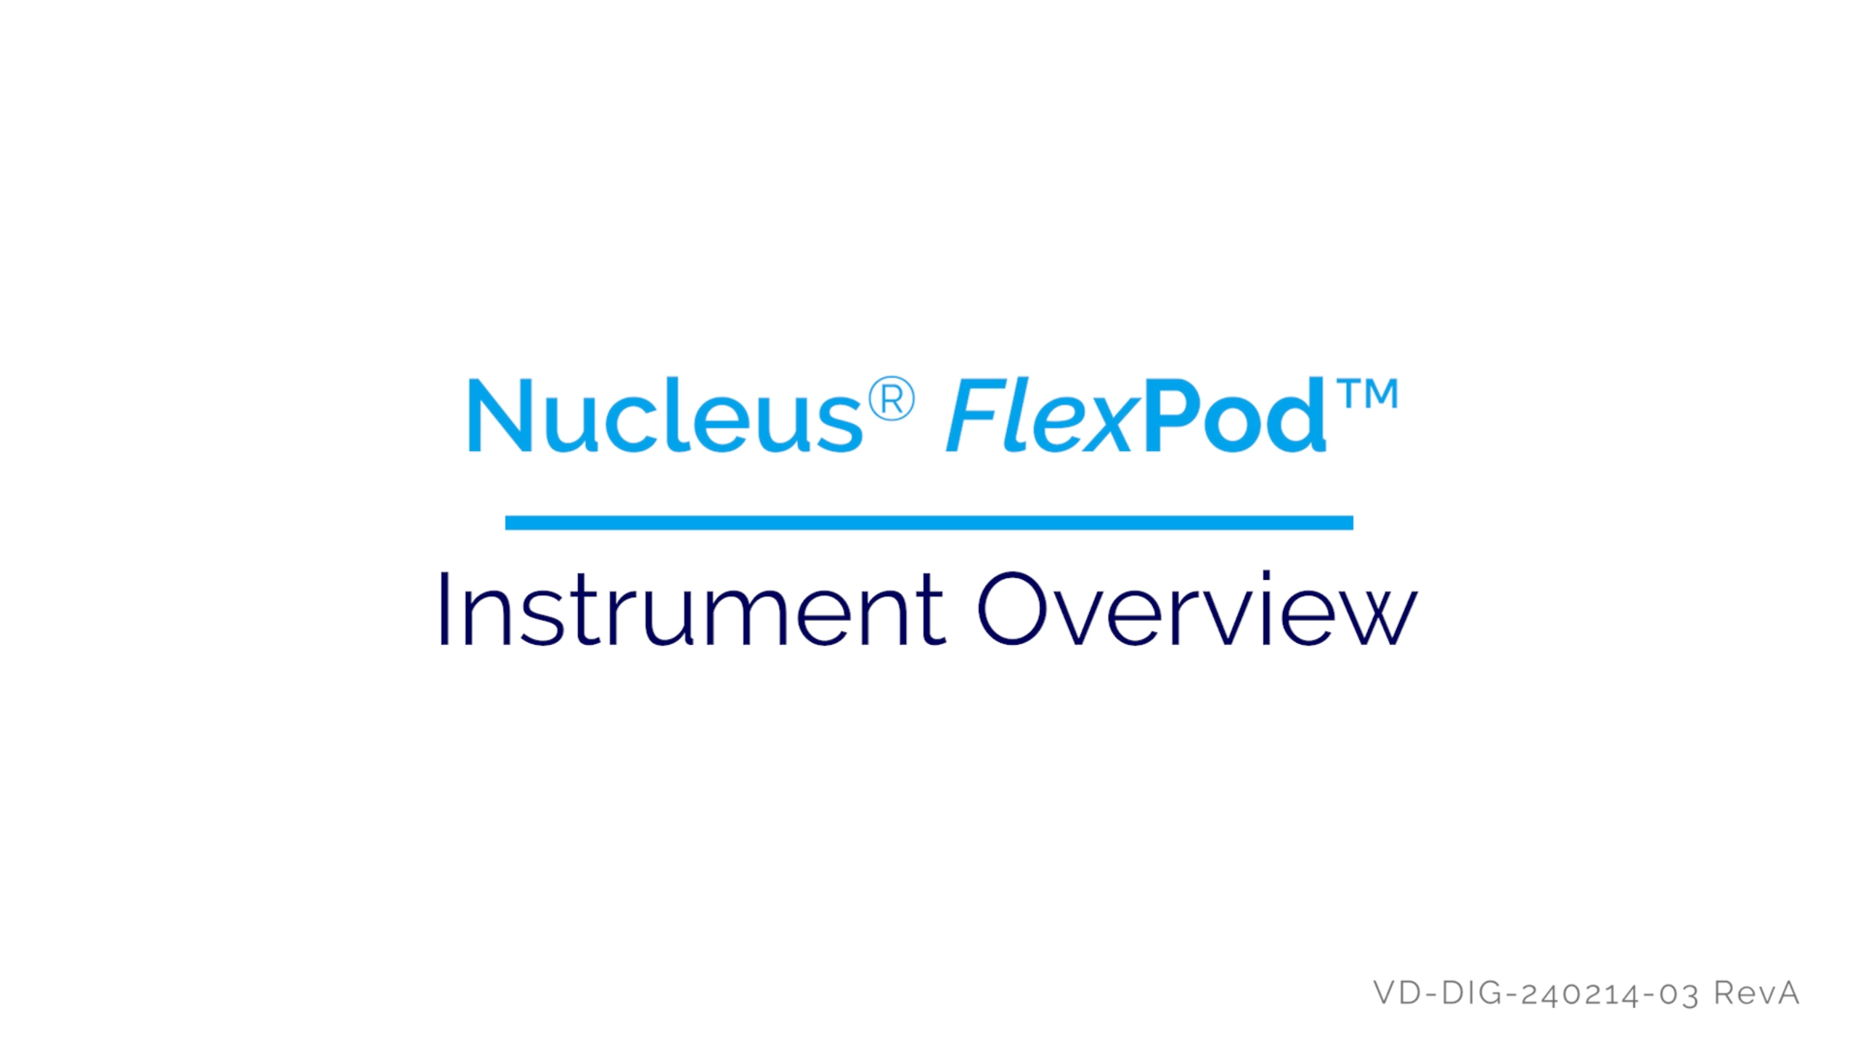
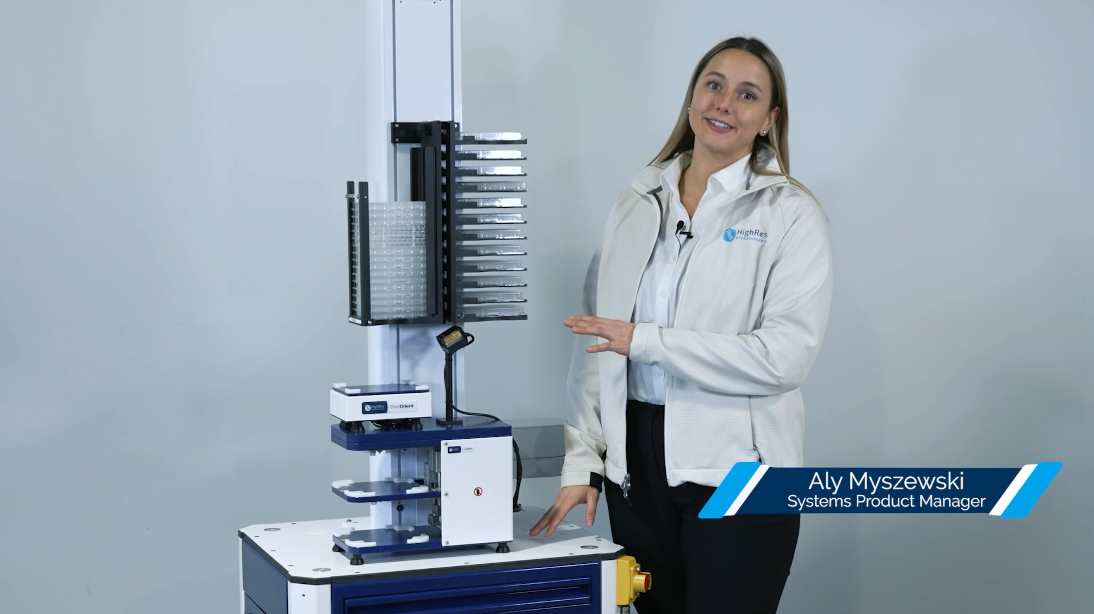
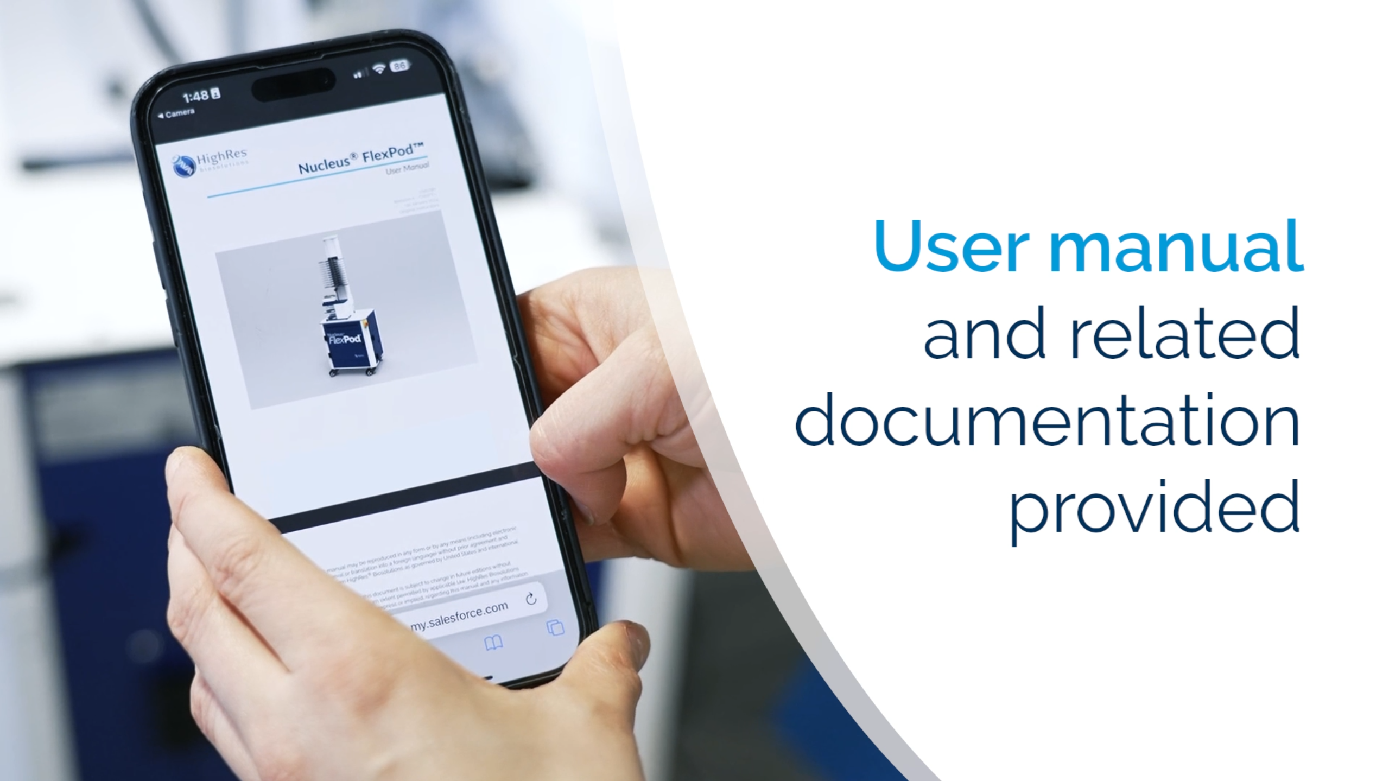
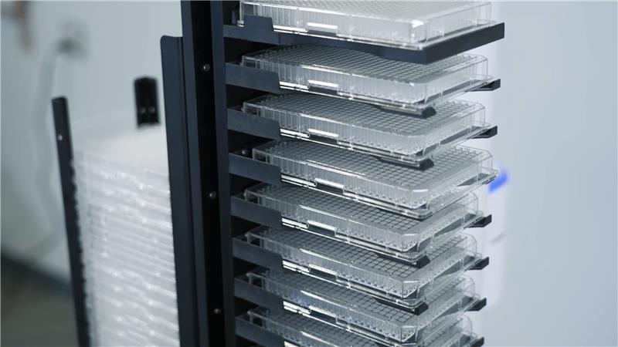
FlexPod Launch Video Series
HighRes® Biosolutions, a leading global laboratory automation company, was looking to introduce their latest innovation, FlexPod, through a compelling video series. They planned to debut the product with an engaging sizzle video at an upcoming global science and technology conference. Our team handled the full production, sending a videographer to Boston to record the device and walkthrough and fully edited the videos together with proper branding. These videos were later published on HighRes social channels and website.
Our Work
Consulted with the client on scheduling recording dates and a final deliverable timelines
Created shotlists for production based on scripts from the client
Conducted virtual location scouting based on images provided by the client​
Flew a videographer to visit Boston to film content for the FlexPod video series
Transferred captured footage to remote editors to meet deliverables​ schedule
Completed post-production including sound and color correction
Added brand-aligned graphics for text callouts as well as intros and outros
The Result
Delivery of a conference-ready introduction video for the FlexPod
Delivery of 4 social-ready promotional videos for the FlexPod
Delivery of a multi-purpose sizzle video for the FlexPod

Slide 2
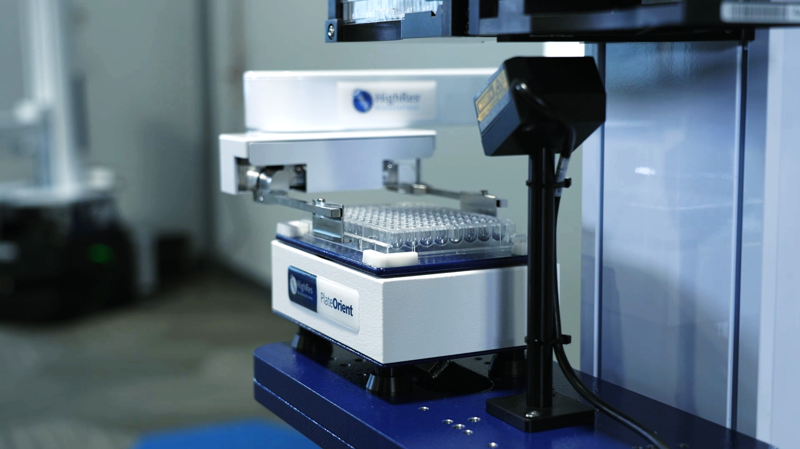
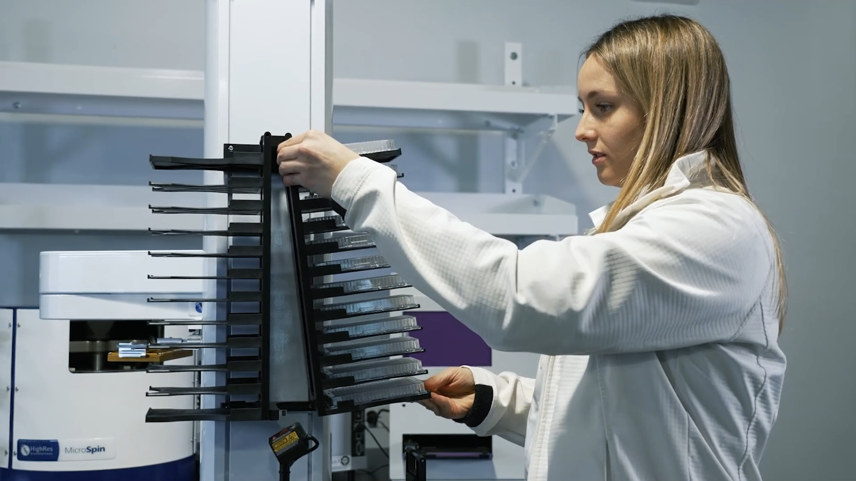
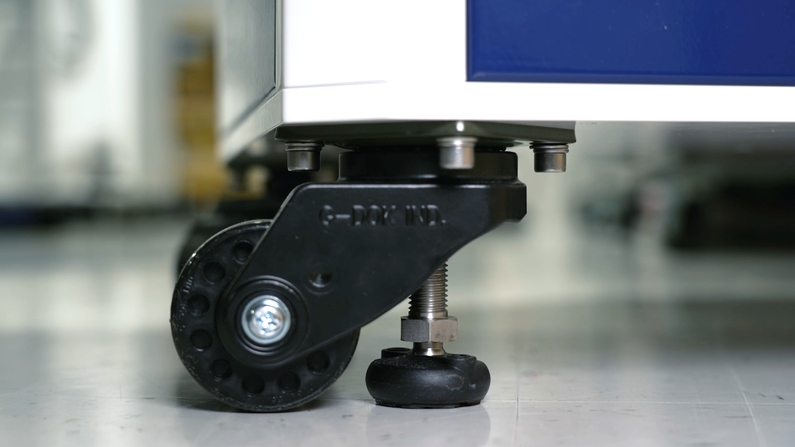
FlexPod Launch Social Metrics
The Flexpod Launch series functioned as a tutorial series for new owners of the device while also showcasing the device's lab capabilities to potential buyers interfacing with HighRes' social media pages. Flexpod social posts featuring our videos garnered some of the highest engagement received throughout FY24 on HighRes LinkedIn page.
Overview
Assembly
Preparation
Delivery
1,723
51
5
67%
Avg. Views
Avg. Likes
Avg. Shares
% of posts
w/ comments

Slide 3
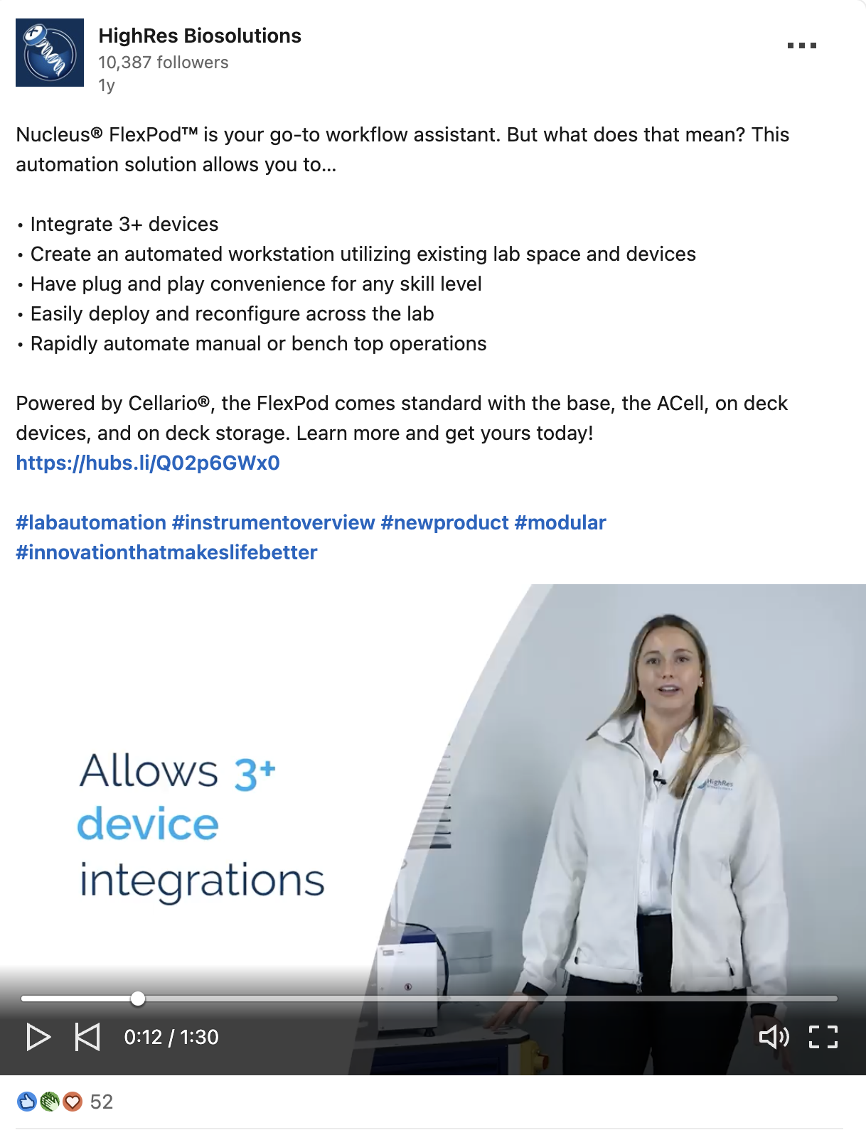
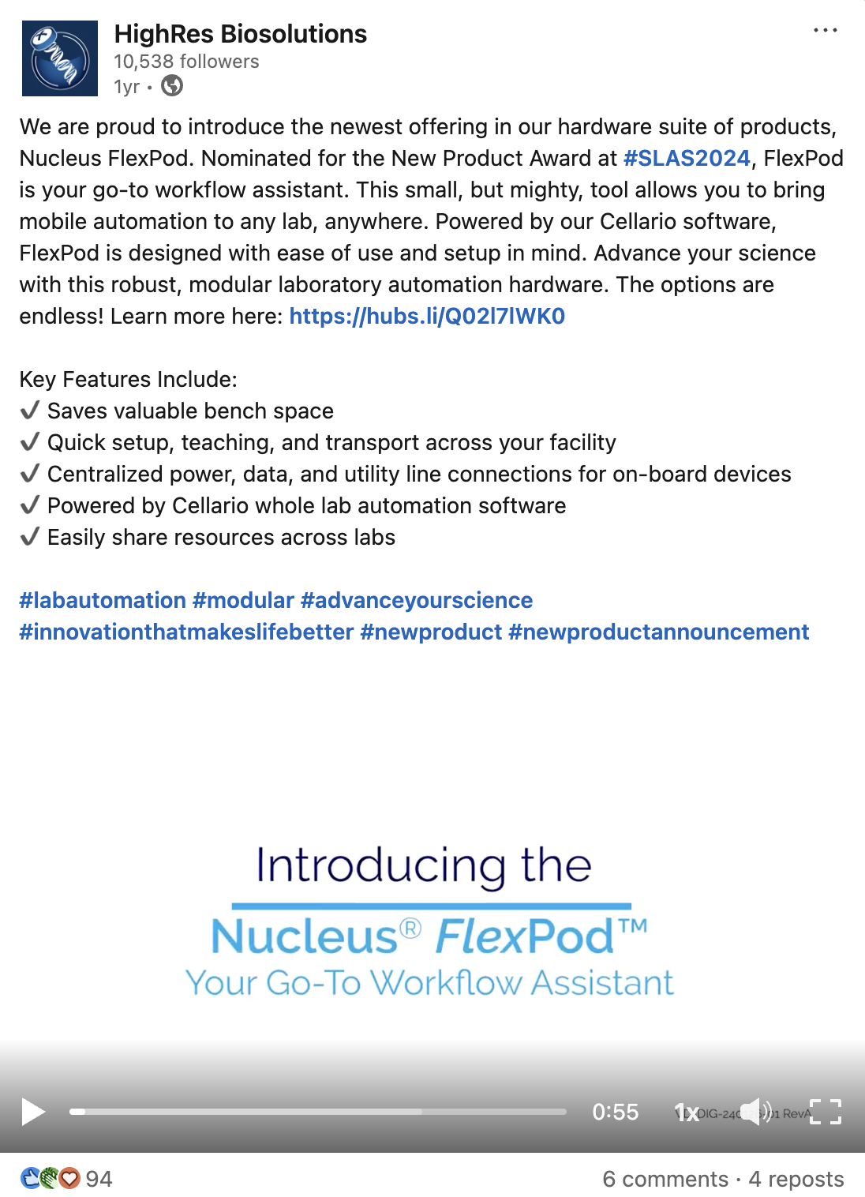
FlexPod Launch Social Metrics
HighRes® LinkedIn channel leveraged our videos across 6 social posts during FY24. All videos enhanced engagement with HighRes’ new product rollout and drew new visitors and clicks to HighRes social page and product website
Introducing the FlexPod
Instrument Overview
Assembly Guidance
4. Instrument Preparation
5. Instrument Delivery
6. FlexPod Social Sizzle
2,152
204
177
Avg. Impressions
Avg. Engagement
Avg. Clicks
9.2%
7%
Engagement rate
Click-through rate

